Slide 1
Project Overview
Introduction to Intelligent System
2022.05.02

Slide 2
Timeline
Preliminary Project 1
Ubuntu, ROS Installation
Preliminary Project 2
Keyboard Control
4/27
~ 5/18
Project 1
Expert Data Collection
5/18
~ 6/1
Project 2
Behavior Cloning
6/6
~ 6/10
CONTEST WEEK
Racing Competition (Simulation)
6/17
RC Car Racing
RC Car Racing in Real World

Slide 3
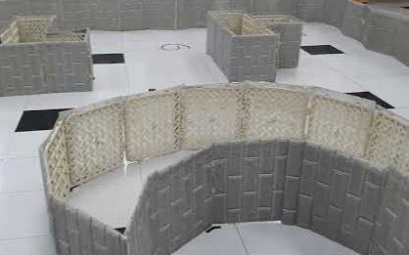
Teams
TEAM1: RACECAR
TEAM2: CALIFORNIA HOUNDS
TEAM3: GOTOMARS
TEAM4: HYBRID
TEAM5: MAZE RUNNER
TEAM6: MELON MUSK

Slide 4


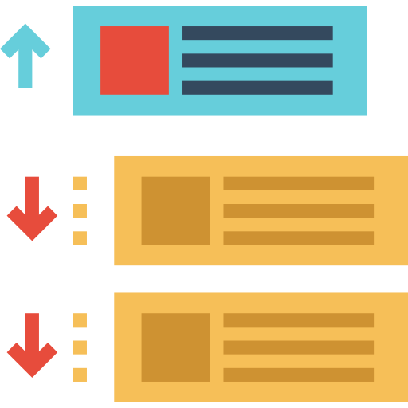

Competition Procedure
Submission Method
- From project 1, you will use Github for your team projects.
- Your project will be graded via webserver.
Submission
Team History
LeaderBoard

Slide 5

Thank you

