Slide 1
Git 101
Introduction to Intelligent System
2022.05.02

Slide 2

Overview
Introduction : What is Git?
How does git work?
Git Tutorial

Slide 3


Introduction
What is Git?
Git - Version Control System
Github - Code hosting platform for version control and collaboration.

Slide 4

Introduction
Version Control
Version control keeps record of your changes in codes
Allows you to revert any changes and go back to a previous state
We can restore our previous codes!
new.py
new_final.py
new_finalfinal.py
new_bestmostfinal.py

Slide 5



How does Git work?
Repository
remote repository
Files are managed in remote server. Users can push(upload)/pull(download) files to this repository.
Local repository stores files in my local PC.
A
B
C
local repositories

Slide 6
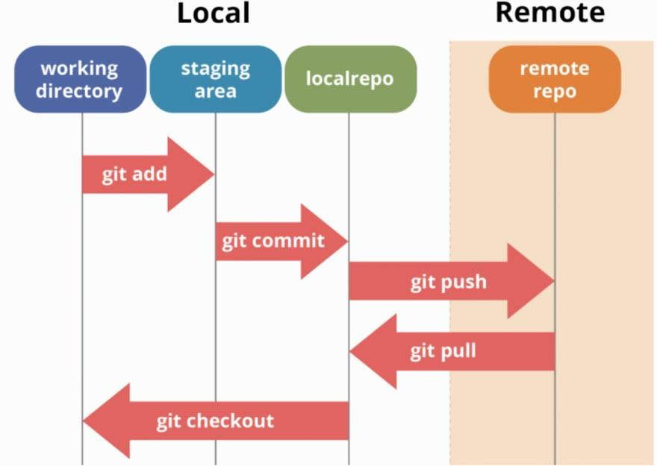
How does Git work?
Basic Git commands
git init
create a new local repository
git remote add origin <server>
connect to a remote repository
git add [file]
adds a file to the staging area
git commit –m “commit message”
records staged files in version history
git push origin <branchname>
sends commited changes of your branch
to your remote repository
git pull origin <branchname>
update from the remote repository

Slide 7
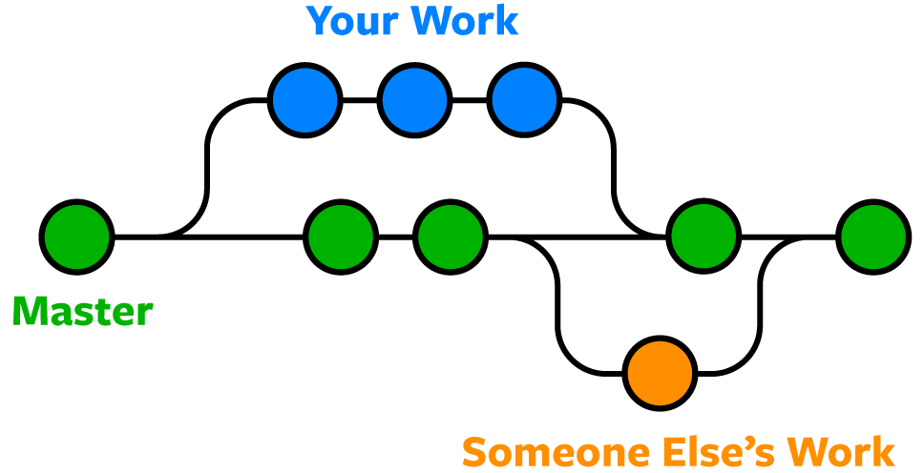
How does Git work?
What is Branch?
“branch1”
git branch
lists all the branches in your repo and show your current branch
git checkout –b <branchname>
create a new branch and switch to it
git checkout <branchname>
switch from one branch to another
git merge <branchname1> <branchname2>
adds a file to the staging area
Main
“branch2”
“main” is
also a branch

Slide 8
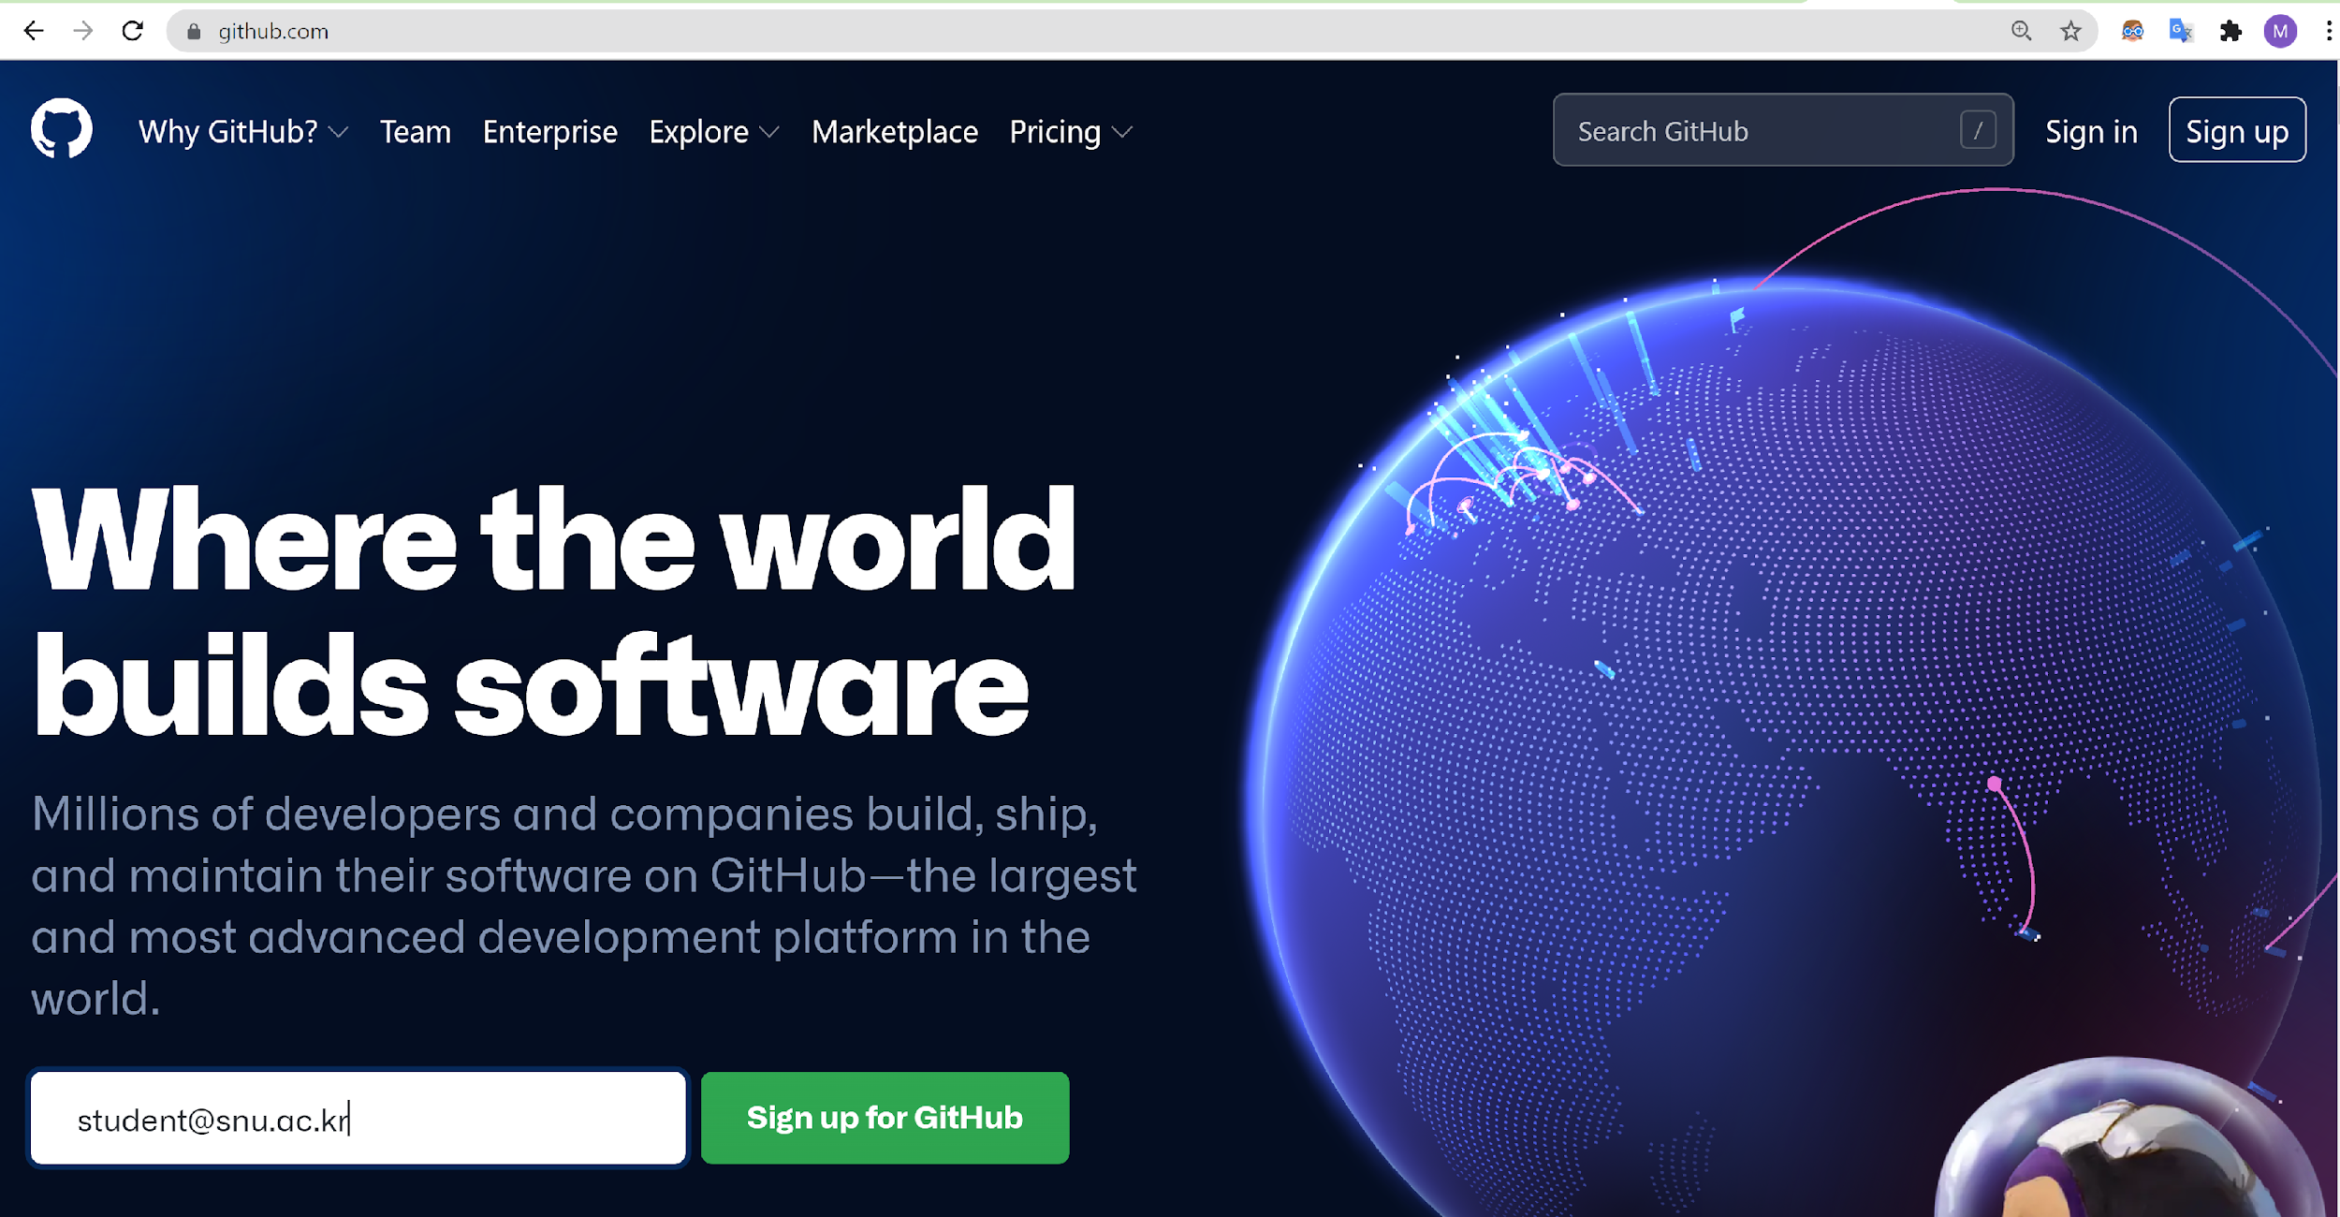
Git Tutorial
1) Install Git and create Github account
Linux
sudo apt-get install git
Create Github account
https://github.com/

Slide 9
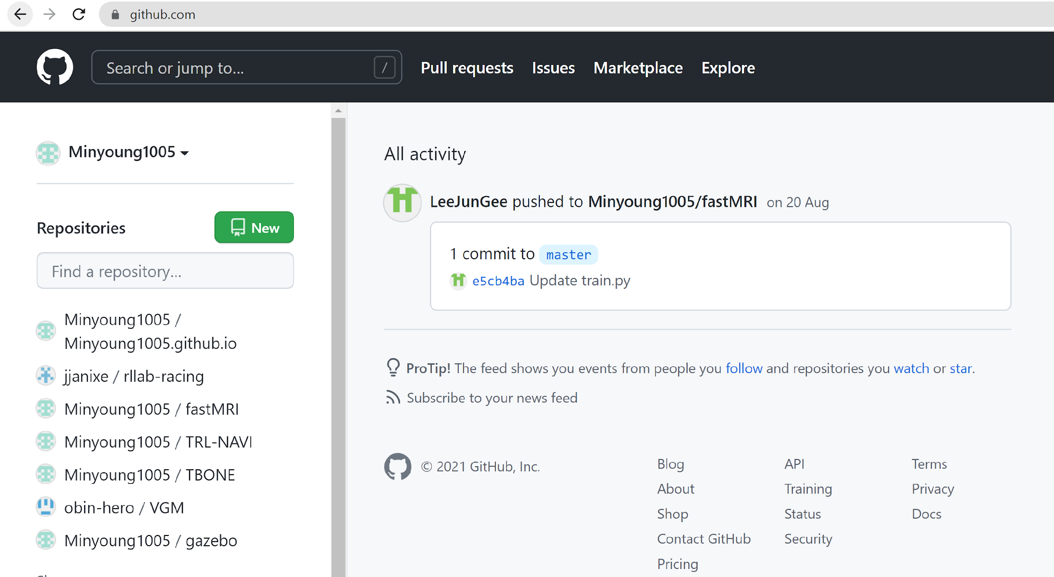
Git Tutorial
2) Make your own private repository
Github web page -> new repository
1
2

Slide 10
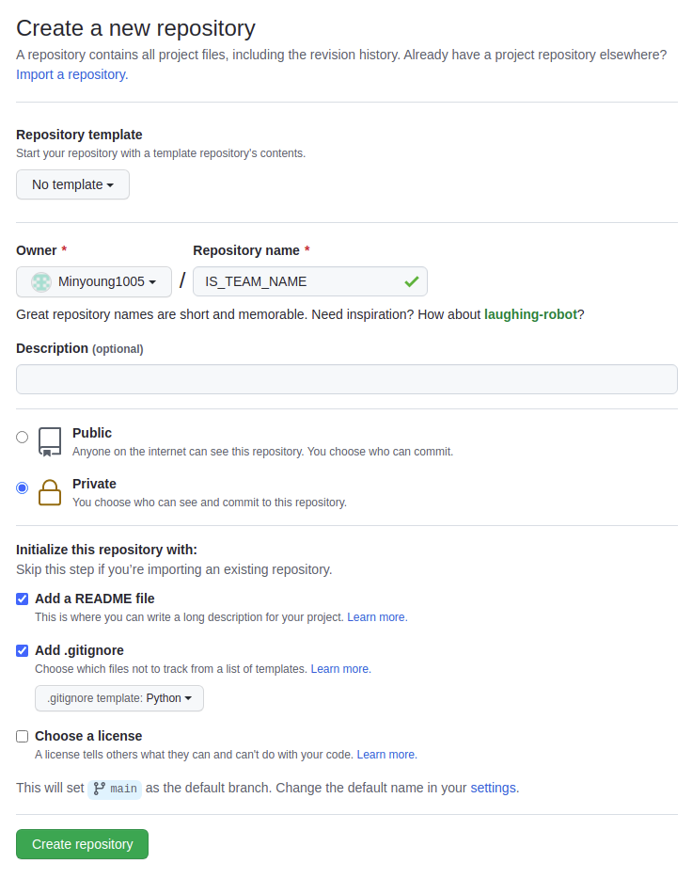
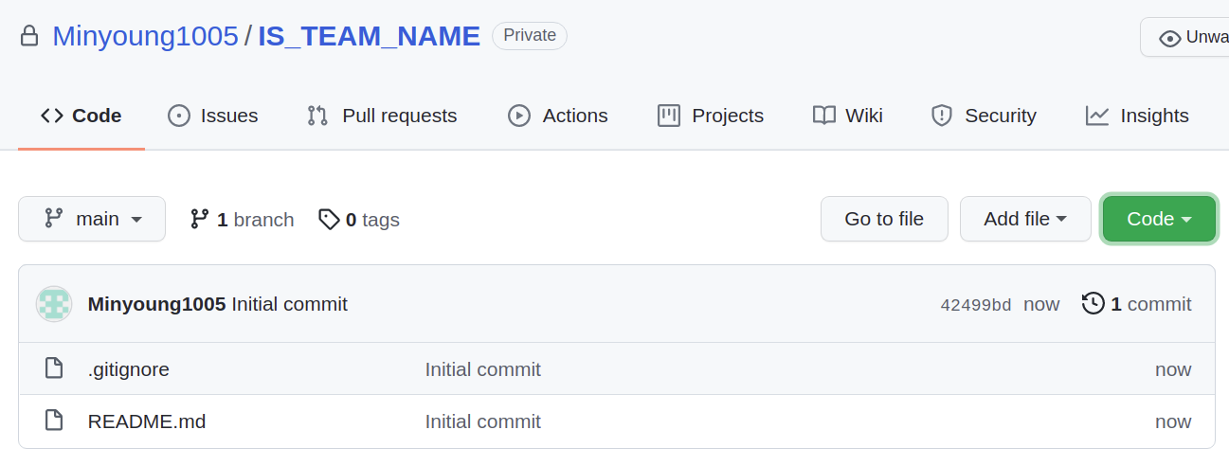
Git Tutorial
2) Make your own private repository
Make sure to make your repository “private” so that other teams cannot view your team’s code. Repository name should follow
IS_{TEAM_NAME} format. (e.g. IS_RLLAB)
Main page of your repository
3

Slide 11
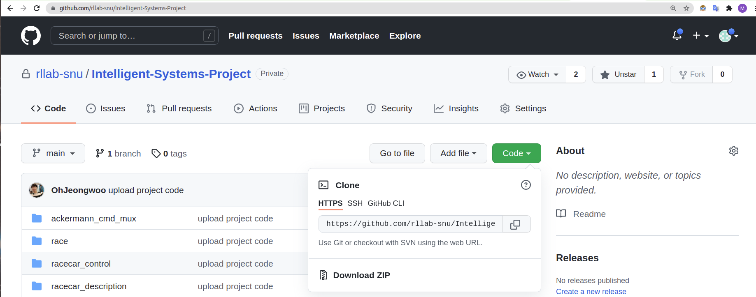
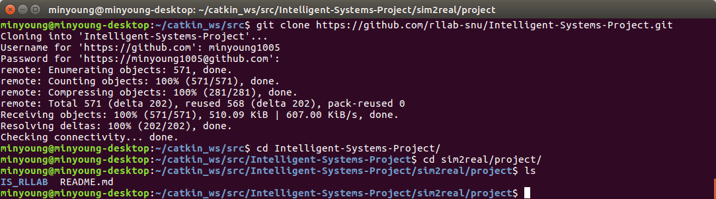
Git Tutorial
3) Clone IS-Project repository on your local PC
git clone https://github.com/rllab-snu/Intelligent-Systems-Project.git
1
2

Slide 12
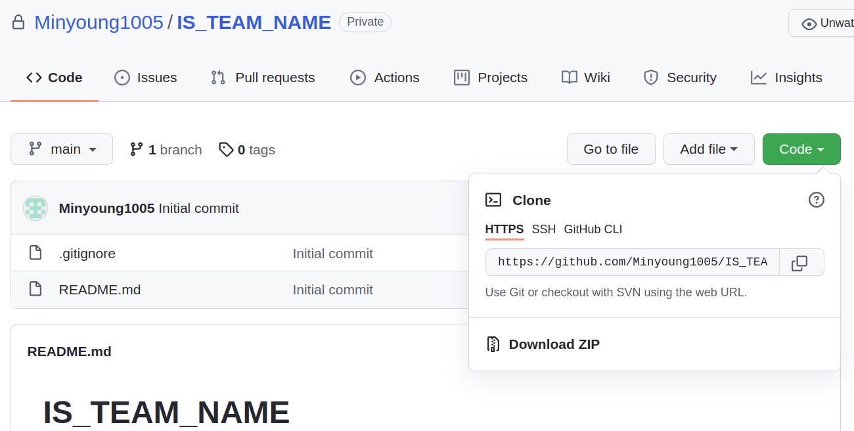
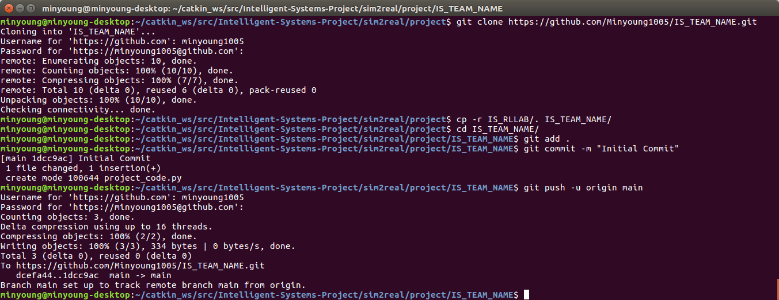
Git Tutorial
4) Clone your private IS_{TEAM_NAME} repo
git clone https://github.com/{username}/IS_{TEAM_NAME}.git
cp –r IS_RLLAB/. IS_TEAM_NAME/
cd IS_TEAM_NAME/
git add .
git commit –m “Initial Commit”
git push –u origin main
1
2

Slide 13
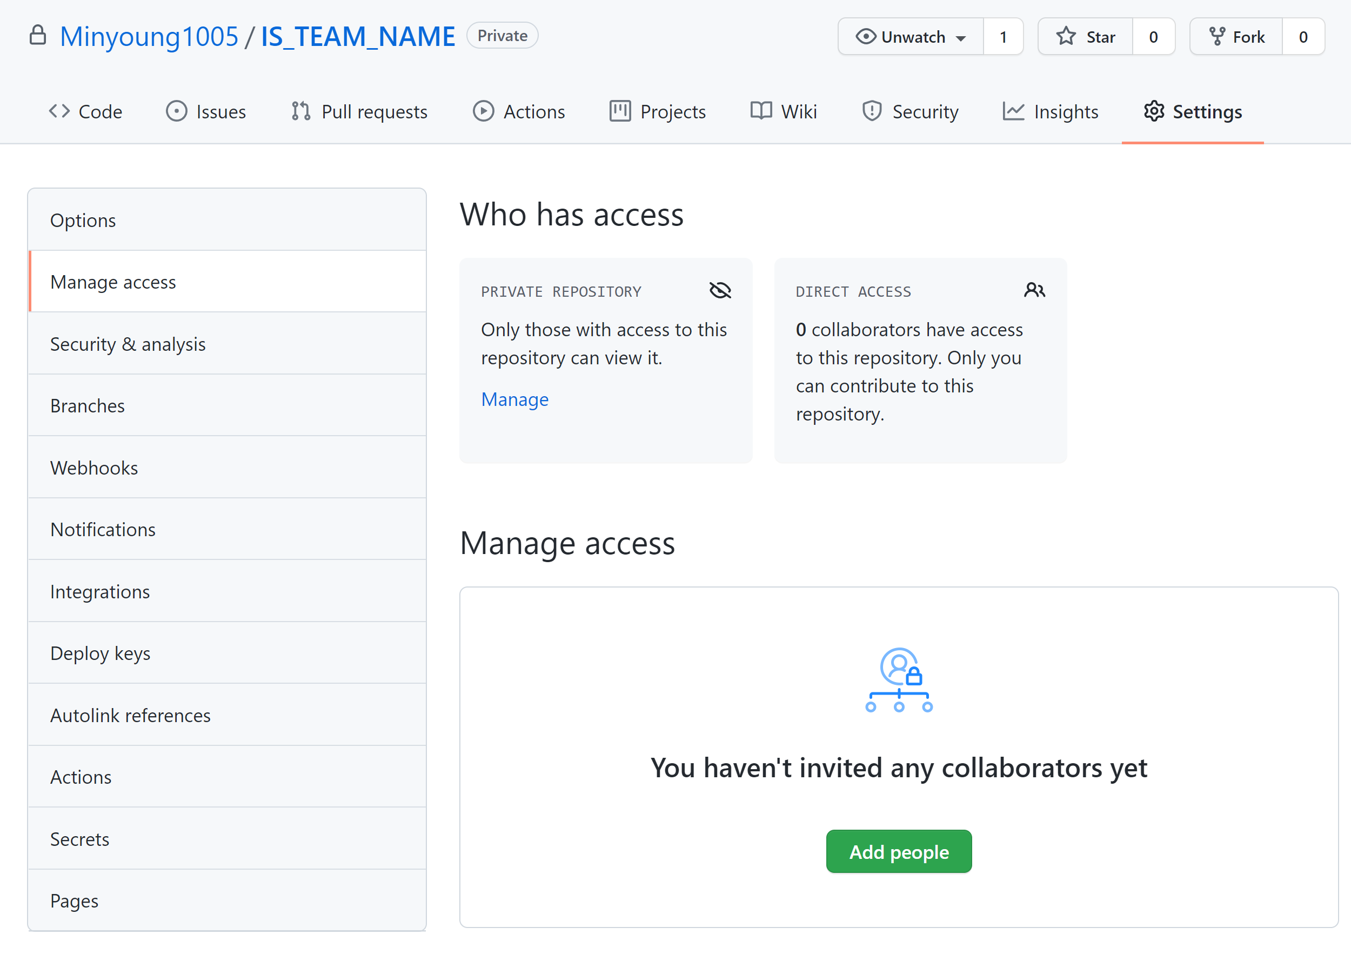
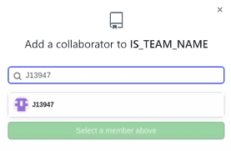
Git Tutorial
5) Add team members and TA as collaborators
1
2
3

Slide 14
Git Tutorial - Summary
6) Modify your codes!
# Upload your local codes to remote repository
git add .
git commit –m “commit message”
git push –u origin main
# Download remote repository’s codes to local PC
git pull origin main
# make branch
git checkout –b <branchname>
git merge <branchname1> <branchname2>
# undo local changes
git fetch origin
git reset –-hard origin/main
For more git commands, go to this link
https://confluence.atlassian.com/bitbucketserver/basic-git-commands-776639767.html

Slide 15
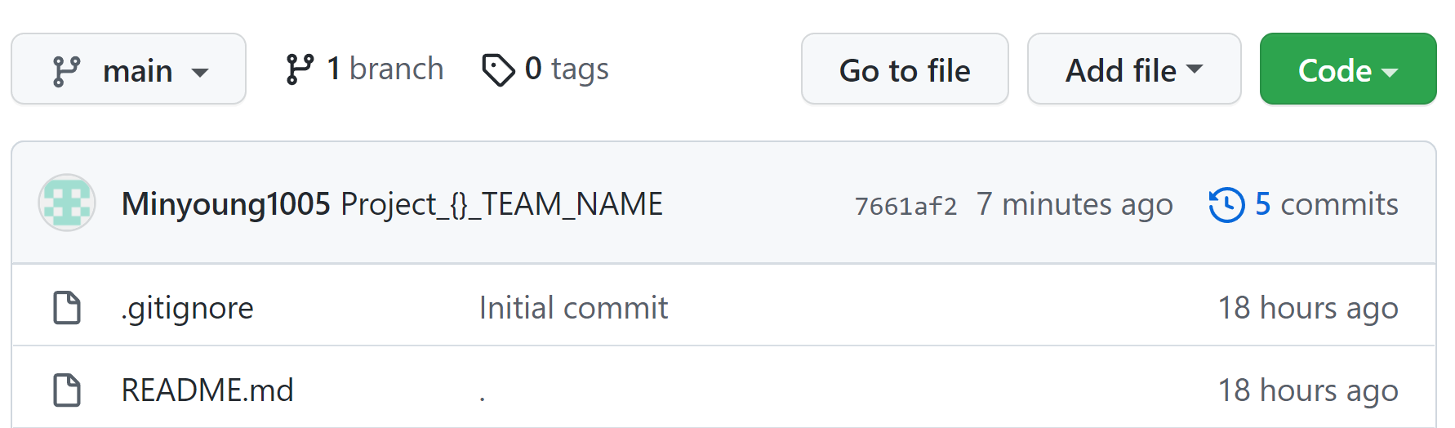
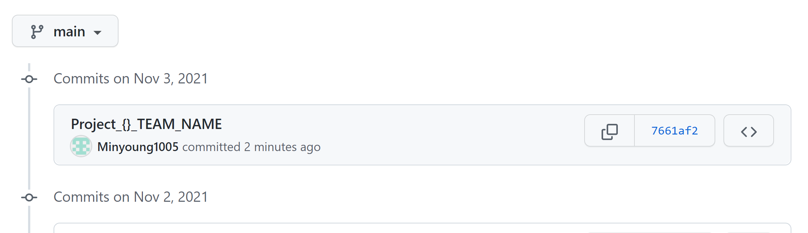
Submission Format
Commit your final project code with commit message “Project_{}_TEAM_NAME”. (e.g. “Project_1_RLLAB”)
Project 1)
1
2
Screenshot your last commit and upload to eTL.
Never change your commit history manually!

Slide 16
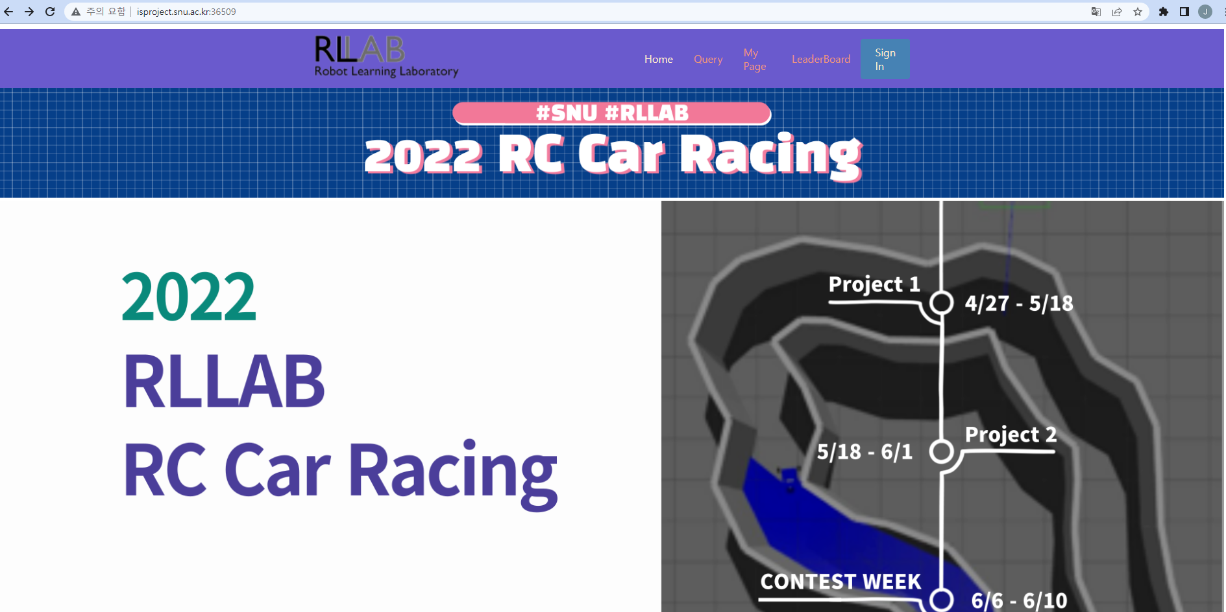
Webserver Submission
1) Access isproject.snu.ac.kr:36509 and login
1
2

Slide 17
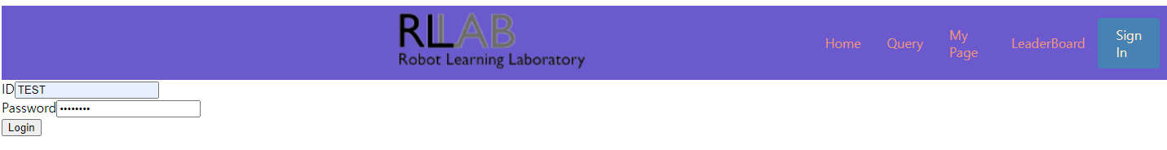
Webserver Submission
2) Login with your team name and pw

Slide 18
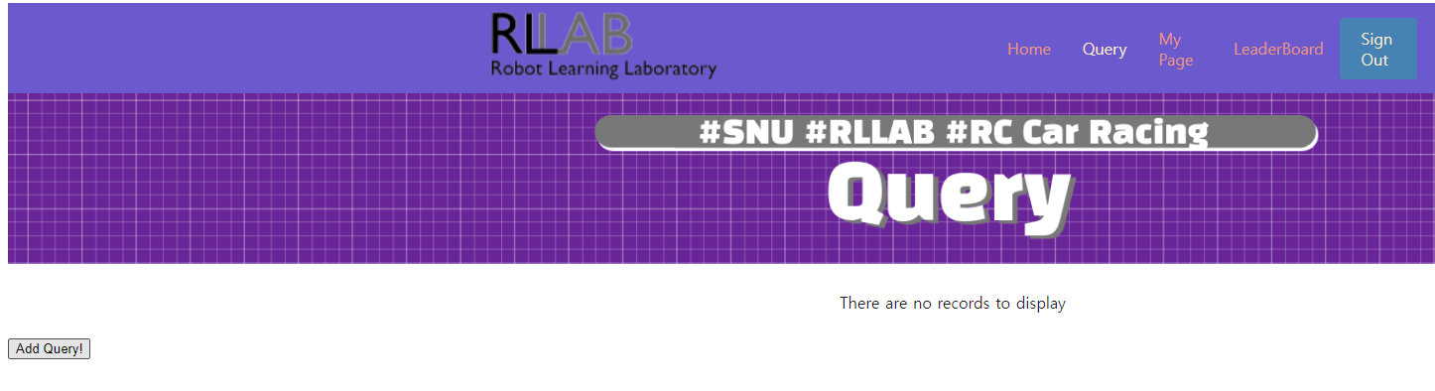
Webserver Submission
3) Submit the code uploaded to your repository.
Go to the Query Section
1
2
Submit your code!

Slide 19
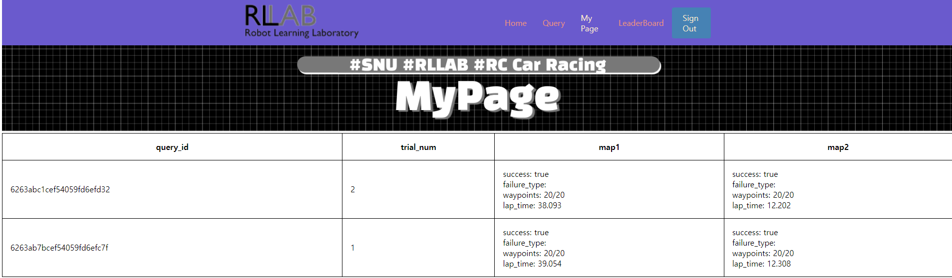
Webserver Submission
3) Check your results through MyPage.

Slide 20
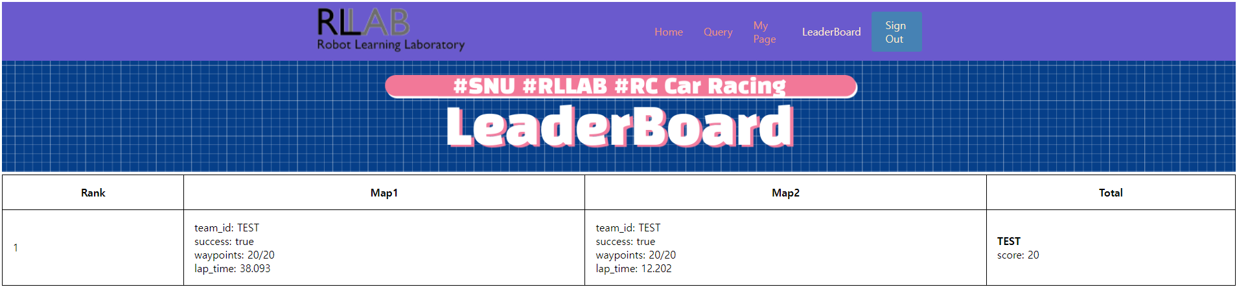
Webserver Submission
4) Check how well you are doing via Leaderboard!

Slide 21

Thank you

